Slide 1
Vast Challenge 2018 MC2 - 1st Progress
Presentation
Rocco, Anthony, Mitchell, Janvi, & Andrew

Slide 2
Contributions
Rocco - Contributed 2 Tableaus/images, completed and organized powerpoint (slides 4-16), presented to the class, coordinated and communicated with teammates
Anthony - Contributed 3 tableaus/images, completed background slide (slide 3), checked/cleaned data with OpenRefine
Mitchell - Contributed 5 Tableaus/images, communicated and assisted teammates with Tableau and Data, proofread slides
Janvi - Contributed 1 Tableau/images, checked data using OpenRefine, completed and organized powerpoint (slides 4-16)
Andrew

Slide 3

Background Information
The Kasios Furniture Company was accused of causing environmental damage to the Boonsong Lekagul Wildlife Preserve through waste dumping and air pollution. However, Kasios is fighting the accusations.
We have been given several years of water sensor readings from the preserve that measure many different chemicals in the different areas of the preserve. Our job is to use visual analytics to see if we can find something in the data that proves wrongdoing.

Slide 4

Our Question
Characterize the past and most recent situation with respect to chemical contamination in the Boonsong Lekagul waterways. Do you see any trends of possible interest in this investigation?
What anomalies do you find in the waterway samples dataset?

Slide 5
Possible Areas of Interest
Years:
The gap from 1998 to 2016
2003
2016
Chemicals:
Iron
Mehtylosmoline
Aluminum
Locations:
Boonsri
Chai
Kannika

Slide 6
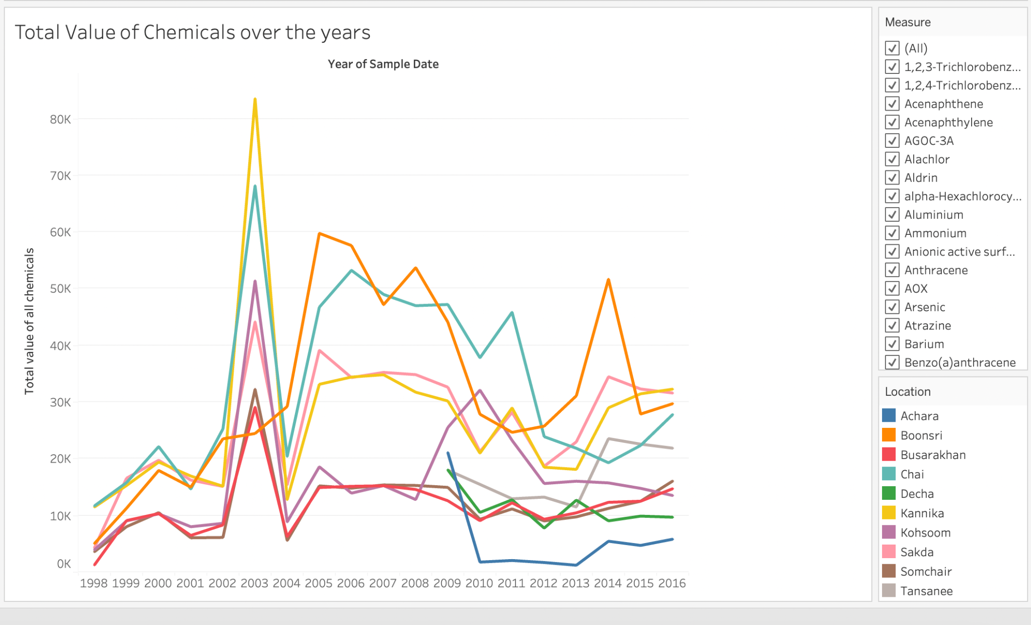

Slide 7
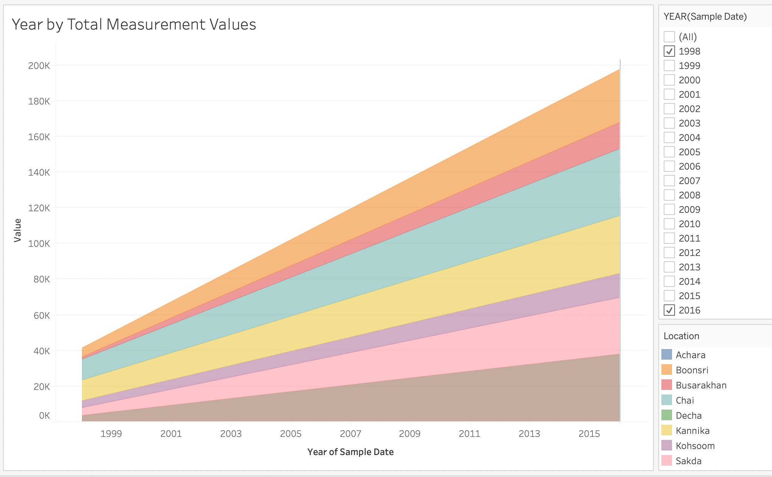

Slide 8
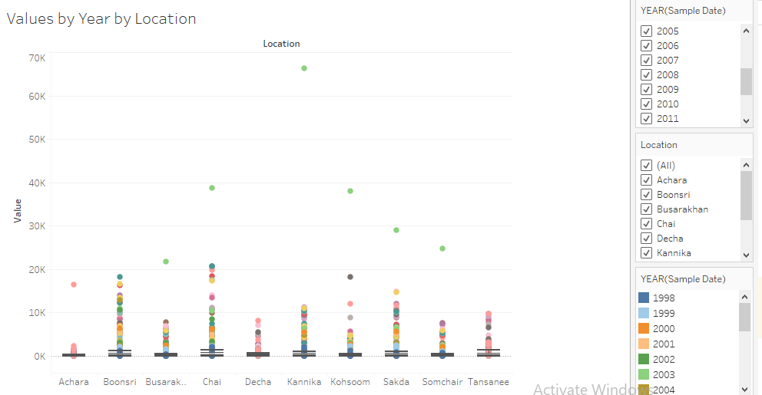
Many outliers shown in each year at each site. Specifically 2003 and 1998 as seen by their colors (Dark Blue and Green). The highest value outlier was Iron.

Slide 9
A Deeper Look Into Iron Jump
Occurred on August 15th, 2003
Previous and post measures of Iron were often in the low single-digits and rarely reached higher than 20
However, on August 15th, the iron reading was in the 20,000s and 30,000s. This was highly unusual.

Slide 10
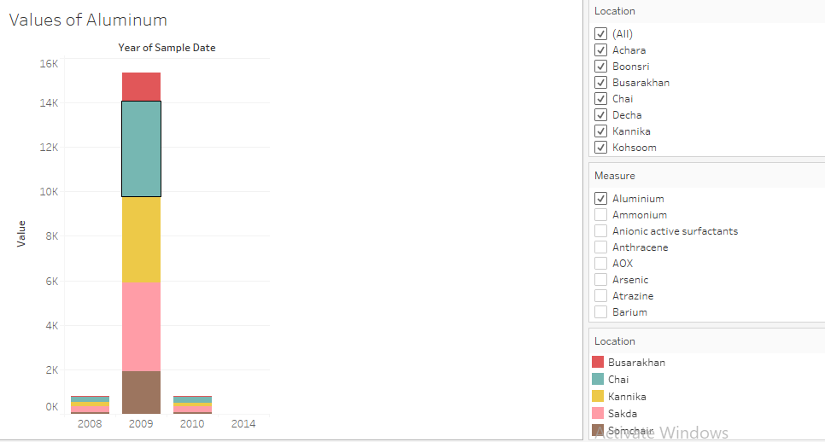
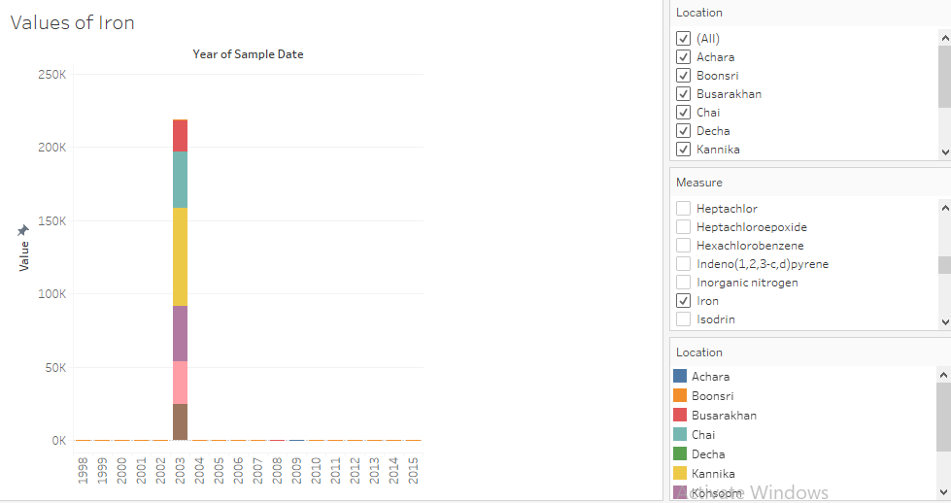
Colors indicate different dumping sites.

Slide 11
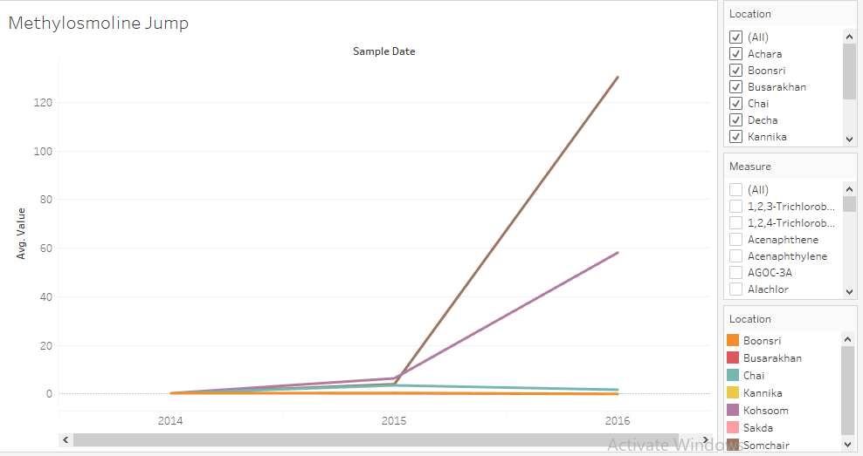

Slide 12
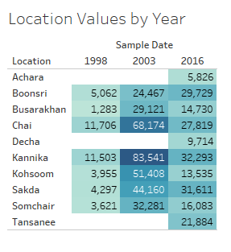
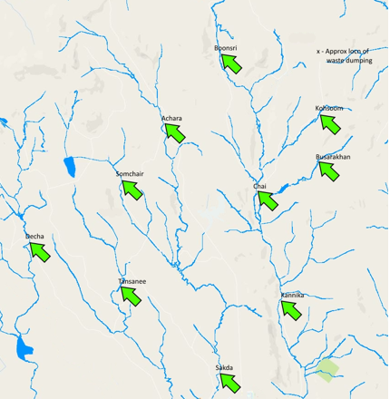
Highest total readings through the years are Boonsri and Chai, with Kannika in third.
Darkest (highest) reading is 83,541 in Kannika in 2003
Lightest (lowest) reading is 1,283 in Busarakhan in 1998

Slide 13
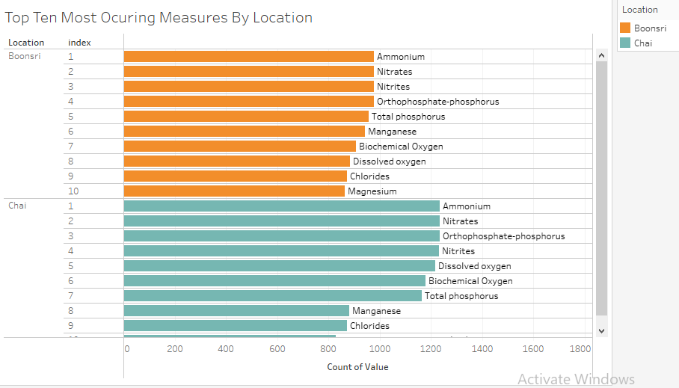
Notes:
These are the two location with the most number of measurements. They have mostly the same top ten measures but some in different order ex. Manganese is the 6th most occurring in Boonsri and 8th in Chai.

Slide 14
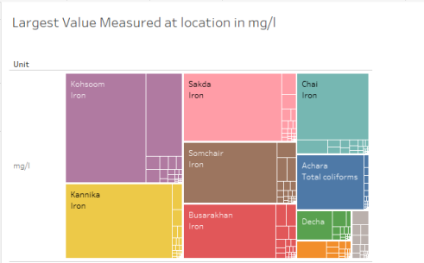
Notes:
The chemical with the largest measurement per location. This shows that Iron had the largest measurement for 6 out of the 10 locations. This can be tied to the spike in iron in Aug 2003.

Slide 15
Iron and Methylosmoline were measured more in Boonsri and Chai than in any other dump sites.
Both of these sites had the highest total sum of chemical output as throughout the years as well.
It seems there may be a link between these two sites and those chemicals.

Slide 16

Findings
There has been a definite increase in total amounts of chemicals from 1998-2016 (18 year period).
Specific years of interest include, 1998, 2003, 2009, and 2016
Data is incredibly varied and inconsistent with each region.
Potential trends could be in the chemicals of iron, aluminum, and methylosmoline.

Slide 17
Thank you!

